Slide 1



Project Day
Batch 3 - Module 7
Instructor: Nahiyan Habib Khan

Slide 2
Topics Covered
Database
Tables
Relationship between tables
SQL Query Writing

Slide 3
Bus Ticket Booking Database Design
Entities (Tables):
Buses (bus_id (PK), bus_name, bus_type, total_seats)
Routes (route_id (PK), source, destination, fare)
Passengers (passenger_id (PK), name, email, phone)
Bookings (booking_id (PK), booking_date, seat_number)

Slide 4
Bus Ticket Booking Database Design
Entities (Tables): [After relationship]
Buses (bus_id (PK), bus_name, bus_type, total_seats)
Routes (route_id (PK), source, destination, fare)
Passengers (passenger_id (PK), name, email, phone)
Bookings (booking_id (PK), booking_date, seat_number, passenger_id (FK), route_id (FK))
Bus_Route (bus_id (FK), route_id (FK))

Slide 5
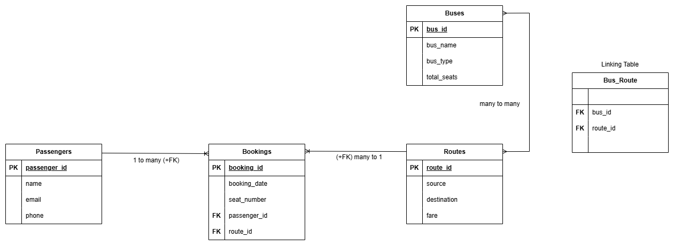
Bus Ticket Booking Database ER Diagram

Slide 6
Bus Ticket Booking Database Queries (1)
-- Create Buses Table
CREATE TABLE Buses (
bus_id INT AUTO_INCREMENT PRIMARY KEY,
bus_name VARCHAR(100) NOT NULL,
bus_type VARCHAR(20) NOT NULL,
total_seats INT NOT NULL
);
-- Create Routes Table
CREATE TABLE Routes (
route_id INT AUTO_INCREMENT PRIMARY KEY,
source VARCHAR(100) NOT NULL,
destination VARCHAR(100) NOT NULL,
fare INT NOT NULL
);

Slide 7
Bus Ticket Booking Database Queries (2)
-- Create Passengers Table
CREATE TABLE Passengers (
passenger_id INT AUTO_INCREMENT PRIMARY KEY,
name VARCHAR(100) NOT NULL,
email VARCHAR(100) UNIQUE NOT NULL,
phone VARCHAR(15) UNIQUE NOT NULL
);
-- Create Bookings Table
CREATE TABLE Bookings (
booking_id INT AUTO_INCREMENT PRIMARY KEY,
booking_date DATETIME NOT NULL,
seat_number INT NOT NULL,
passenger_id INT,
route_id INT,
FOREIGN KEY (passenger_id) REFERENCES Passengers(passenger_id) ON DELETE RESTRICT,
FOREIGN KEY (route_id) REFERENCES Routes(route_id) ON DELETE RESTRICT
);

Slide 8
Bus Ticket Booking Database Queries (3)
-- Create Bus_Route Table (Linking Table)
CREATE TABLE Bus_Route (
bus_id INT,
route_id INT,
PRIMARY KEY (bus_id, route_id),
FOREIGN KEY (bus_id) REFERENCES Buses(bus_id) ON DELETE RESTRICT,
FOREIGN KEY (route_id) REFERENCES Routes(route_id) ON DELETE RESTRICT
);

Slide 9
Module-7 Assignment
Hospital Management System Database Design
Entities (Tables):
Doctors: (DoctorID, Name, Specialization, Phone.)
Patients: (PatientID, Name, Age, Gender, Phone.)
Appointments: (AppointmentID, Date, Time, Status.)
Departments: (DepartmentID, Name, and Room_no.)
Submission Guidelines:
- Submit a clear image of the ER diagram.
- Submit SQL queries in a text file. (Create table and insert 5 data per table)
- Combine the files into a zip file and submit. You can also submit GitHub repo link.

Slide 10

Q&A

Slide 11
Thank You

